Slide 1
JAVA 8

Slide 2
FEATURES/updates
Defining methods in Interface.
Functional Programming.
Lambda Expressions.
Stream API.

Slide 3
Lets Go through some EXAMPLES OF THESE FEATURES

Slide 4
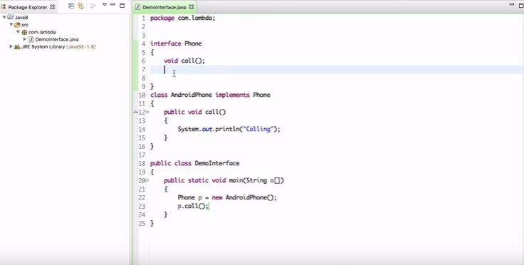
Defining methods in Interface.

Slide 5
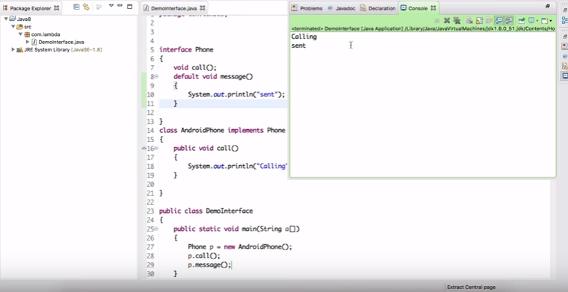
Continued..
What if I want to add another method message….??

Slide 6
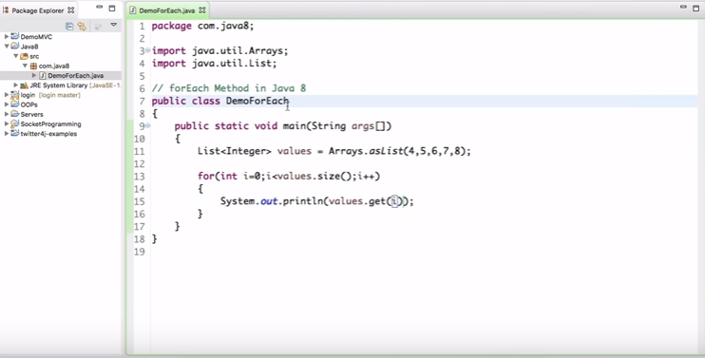
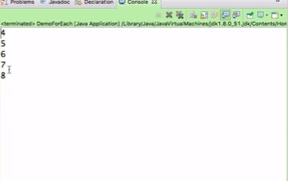
forEach method in JAVA 8:
The question is why we require for each method ??
Lets check it out : For printing a array of numbers what all we do..
Method 1:

Slide 7
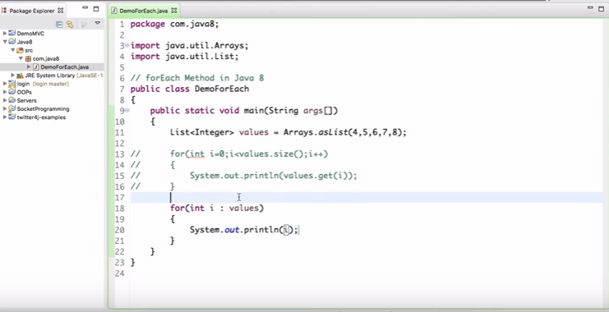
Method:2

Slide 8
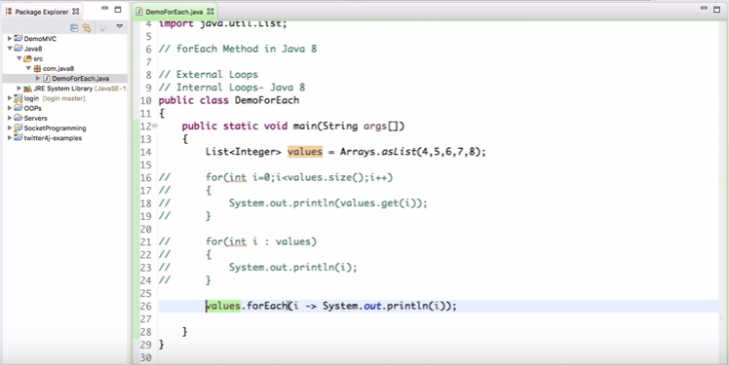
Method 3:

Slide 9
Advantage of foreach loop
Since it’s a internal part of collection it is much faster.
Huge amount of data processing can be done faster using this method.

Slide 10
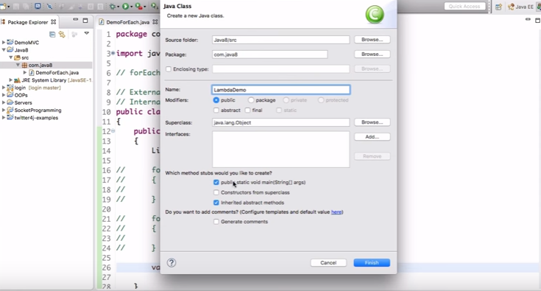
LAMBDA EXPRESSION (->)

Slide 11
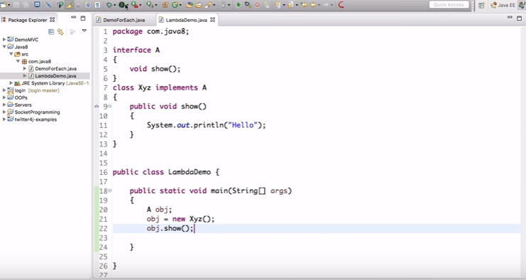
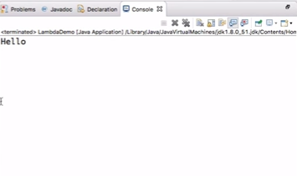
Continued…

Slide 12
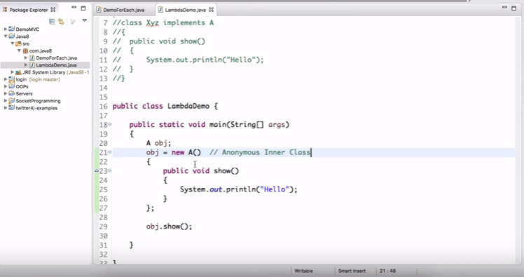
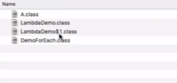
Continued…

Slide 13
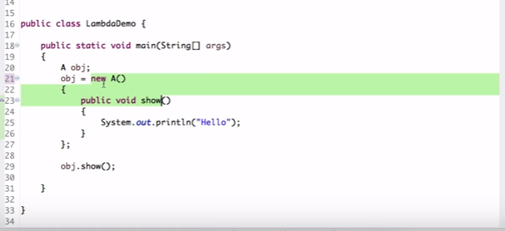

Slide 14
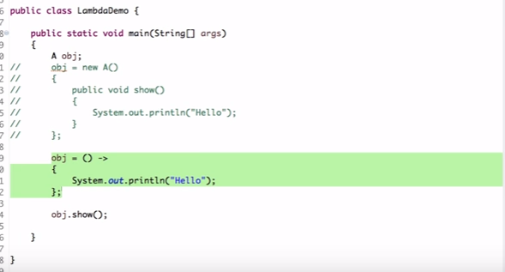
Continued …

Slide 15
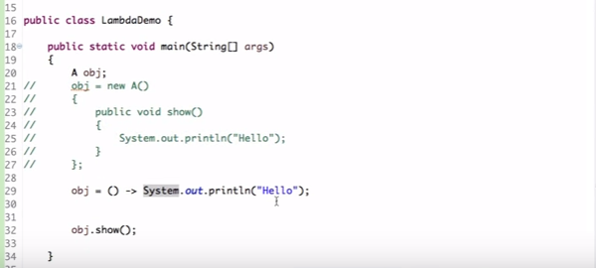
Continued..

Slide 16
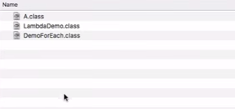
Continued
This is the advantage of Lambda expression.

Slide 17
There is a lot more to it !!

